Slide 1


NAME: EMMANUEL INEGET
ACCESS No.: B30915
Reg. No.: S24M10/003
COURSE NAME: DATA ANALYSIS AND PROCESS MINING
COURSE CODE: DSC8204
COURSE FACILITATOR(S): DR. DAPHINE NYACHAKI BITALO

Slide 2

PART A
GitHub Link below to PART A
https:

Slide 3
PART B
Findings and recommendations for the varying goals investigated.

Slide 4
Presentation Outline:
Goal 2 - Natural Language Processing in the Law
Goal 3 - Improving efficiency and understanding of the financial logs provided
Goal 4 - Prediction of Heart Arrhythmia in the Health Sector
Conclusion

Slide 5
Goal 2 -Natural Language Processing in the Law [1/4]
Context:
The comprehension of legal judgements dispensed by courts of law in Uganda and globally, especially on matters of public interest, is often low. Several factors contribute to this including complex language usage and long legal briefs. Therefore, using natural language processing tools, one is able to lessen the aforementioned hurdles.
Two judgments were mined from the Uganda Legal Information Institute (ULII) website (in 2024)
Judgement 1:
Majari Investments Limited v Betimo General Supplies Limited & Another (Civil Suit 562 of 2020) [2024] UGCommC 347 (31 December 2024)
Judgement 2:
Mukamuriza v Karugaba & 2 Others (Civil Suit 554 of 2020) [2024] UGCommC 346 (31 December 2024)

Slide 6
Goal 2 -Natural Language Processing in the Law [2/4]
Summary:
Key findings:
Two judgments mined from the Uganda Legal Information Institute (ULII) website (2024)
Judgement 1:
Process | Tools used
Web scrapping | Requests, BeautifulSoup
Text Preprocessing & cleaning | nltk, re, string
Text Summarization | transformers, sumy
Data Transformation | pandas, numpy, csv
Text Exploration | TfidfVectorizer, matplotlib, seaborn, WordCloud, Counter
The Plaintiff sought recovery of USD 154,929, alleging the Defendants requested funds for a consignment of wine. The Defendants denied the claims, citing no written contract and disputing the alleged arrangement. The Court held that the Plaintiff's claim was based on equitable restitution and unjust enrichment, not enforcement of a written contract.
Judgement 2:
The Plaintiff sought ownership of land she claimed to have purchased through her then-fiancé, the 1st Defendant. The Court found no evidence substantiating her claim, including the absence of a sale agreement.

Slide 7
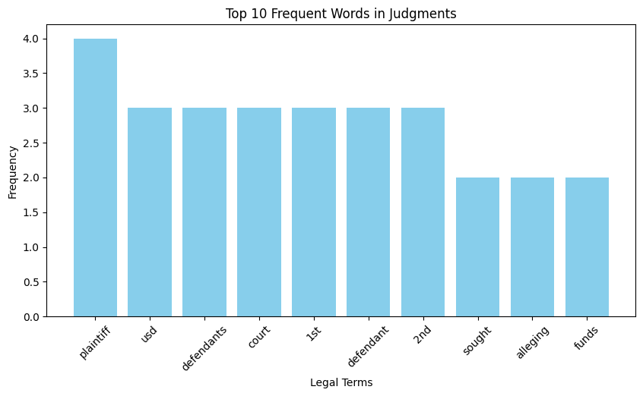
Goal 2 -Natural Language Processing in the Law [3/4]
Text Data Exploration:
A bar chart was designed showing the distribution of case legal outcomes

Slide 8
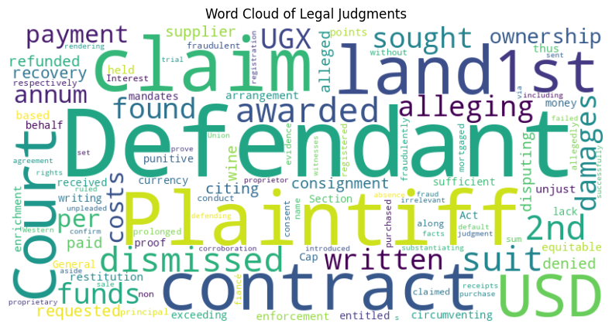
Goal 2 -Natural Language Processing in the Law [4/5]
Word cloud highlighting the most common words in the Summary Text of the judgements
Insights:
Common legal terms like “Contract,” “plaintiff,” and “defendant” dominate the text.
Outcomes are skewed towards specific verdicts, indicating trends in legal decisions.

Slide 9

Goal 2 -Natural Language Processing in the Law [5/5]
Word cloud highlighting the most common words in the Case Text column
Insights:
Common legal terms like “Court,” “case,” and “act” dominate the text.
Outcomes are skewed towards specific verdicts, indicating trends in legal decisions.

Slide 10
Goal 3 - Improving efficiency and understanding of the financial logs that were provided [1/5]
Introduction & Context
Process mining supports the analysis of business processes based on event logs by identifying trends, patterns and details contained in event logs recorded by an information system. Use the process mining tools to improve efficiency and understanding of the financial logs provided.
Data Source:
Dataset: “financial_log.xes” containing financial event logs.
Preprocessing Steps:
Data cleaning: Checked for missing values, duplicates and standardize event log formats.
Data transformation: Converted event logs into a suitable format for process mining tools i.e., CSV format.
Tools: Python libraries like pandas and pm4py for preprocessing.
Outcome:
Cleaned and structured event logs ready for analysis.

Slide 11
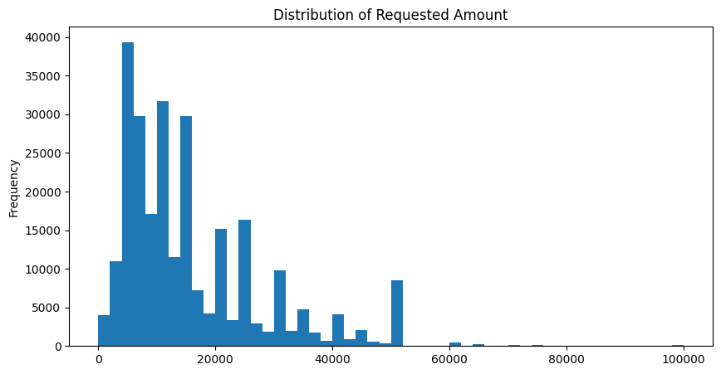
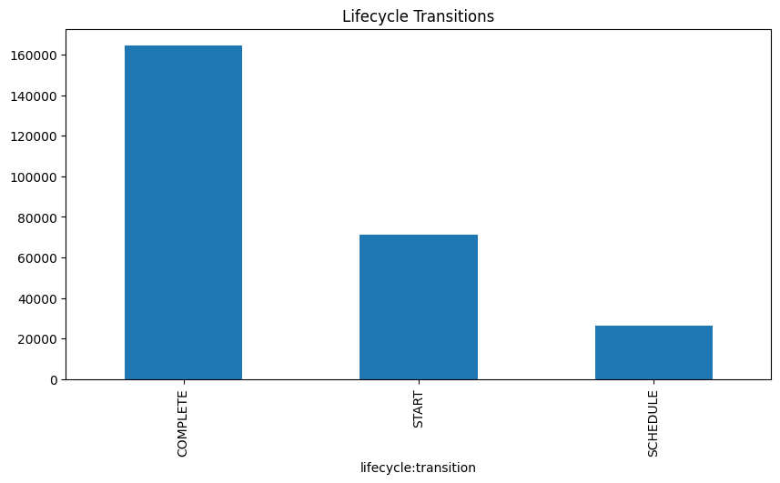
Goal 3 - Improving efficiency and understanding of the financial logs that were provided [2/5]
Event Logs Exploration
"COMPLETE" has the highest count, indicating most activities reach completion.
"START" has significantly fewer occurrences, suggesting not all initiated processes progress fully.
"SCHEDULE" has the lowest count, implying fewer scheduled events compared to started and completed ones.
The highest frequency is observed in the lower range, suggesting that smaller requests dominate the dataset.
There are periodic spikes, possibly due to specific standard loan amounts.
The long tail towards larger amounts reflects occasional high-value requests.

Slide 12
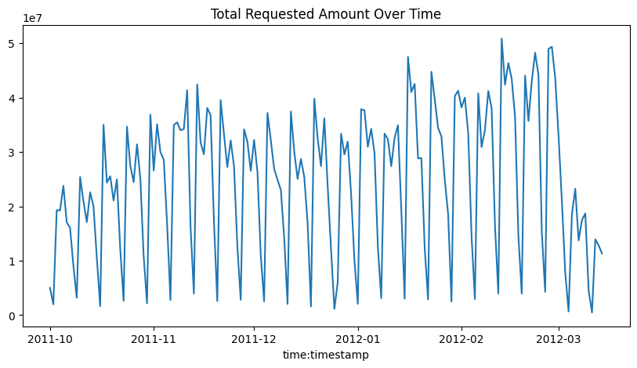
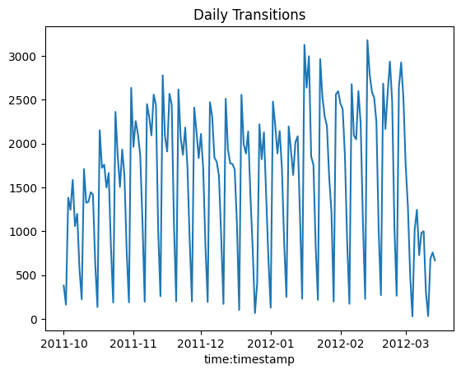
Goal 3 - Improving efficiency and understanding of the financial logs that were provided [3/5]
Data trends from October 2011 to March 2012,
with the x-axis representing time and the y-axis showing a metric related to transitions.
illustrate daily fluctuations or patterns in activity over the six-month period.
Peaks and troughs indicate variations, while a steady line suggests consistency.
The graph titled "Total Requested Amount Over Time" tracks the cumulative requested amounts from October 2011 to March 2012, with monthly intervals on the x-axis.
shows trends in demand over time.
Peaks indicate seasonal spikes, while a steady trend suggests consistent requests.

Slide 13
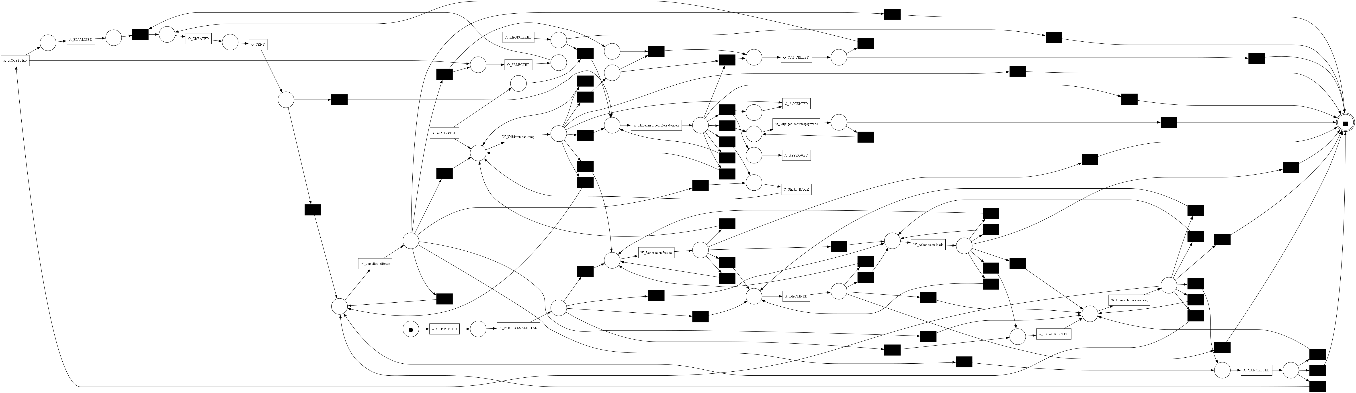
Goal 3 - Improving efficiency and understanding of the financial logs that were provided [4/5]
Process Discovery
The above process model is a complex flow with multiple choice points and simultaneous operations, underscoring its dynamic nature. Critical phases such as "A_ACCEPTED," "A_CANCELLED," and "W_Completeness check" point out significant steps within the process. The presence of multiple paths is evidence that cases branch out under certain conditions. Such variability implies process optimization for the identification of bottlenecks and increasing efficiency.

Slide 14

Goal 3 - Improving efficiency and understanding of the financial logs that were provided [5/5]
Model Evaluation
Recommendations for improving process efficiency based on model insights
The Log Fitness value stands at 0.56, which means that the model captures a modest percentage of the behavior in the event log but still has a significant gap with the model and the actual process. The Average Trace Fitness of 0.65 shows that, on average, the individual traces in the event log are quite well-represented in the model, but there is some room for more alignment. The worst result is the Percentage of Fitting Traces, 0.0%, which means none of the traces in the event log completely fit the process model
An issue with the generalizability of the model to the traces in the event log.
The model requires further refinement to achieve higher accuracy and robustness.

Slide 15
Goal 4 - Prediction of Heart Arrhythmia in the Health Sector [1/9]
Introduction & Context
Data Science gained a reputation for being a highly sought after career when a Harvard Business Review article tagged it “the sexiest job of the 21st century.” This has seen a surge in career changes for many and a demand for data analysts in the job market. As a cohort of the MIT Data Analytics and Process Mining class at UCU, you would like to ensure that the skills you attain are the most sought after in the job market. Therefore, use your acquired skills to get insights into the provided survey data.
Data Source:
Dataset: “arrhythmia1.data.csv” containing medical data.
Preprocessing Steps:
Handling missing values and outliers.
Normalizing or scaling data for analysis.
Encoding categorical variables (e.g., Sex).
Checking for normality of the dependent variable
Statistical tests like ANOVA to check for differences between groups of the categorical variables
Outcome:
Cleaned dataset ready for exploratory analysis.

Slide 16
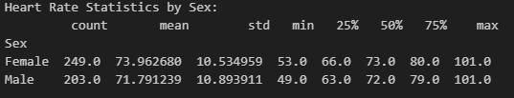
Goal 4 - Prediction of Heart Arrhythmia in the Health Sector [2/9]
Exploratory Data Analysis (EDA)
Females have a slightly higher average heart rate (73.96 bpm) compared to males (71.79 bpm), with similar variability (std: ~10.5–10.9).
Both sexes share comparable median heart rates (females: 73 bpm, males: 72 bpm) and identical maximum heart rates (101 bpm).
While females exhibit a slightly wider interquartile range (66–80 bpm vs. males: 63–79 bpm), the overall distributions of heart rates between the two groups are relatively consistent.

Slide 17
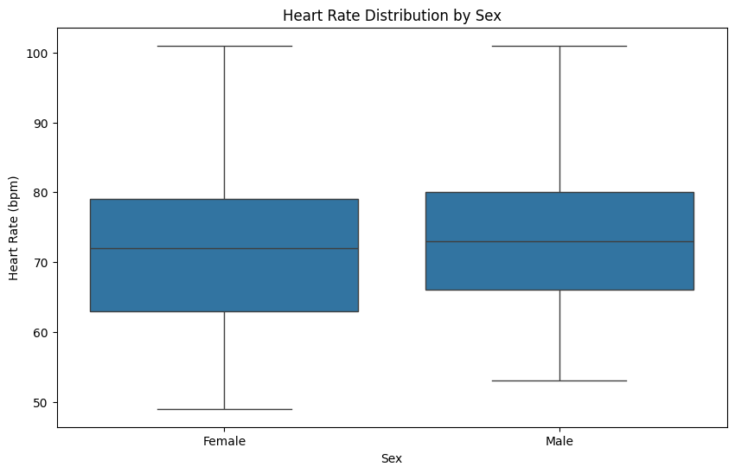
Goal 4 - Prediction of Heart Arrhythmia in the Health Sector [3/9]
Heart rate vs Sex - continued
Both groups have the same range, and their heart rates span from about 50 bpm to just over 100 bpm.
The median is ever so slightly greater for women compared to men, which may suggest a difference in central tendency.
The interquartile ranges (IQR) are almost identical, so variability of heart rate is the same for both sexes.
Both the whiskers extend to the same minimum and the same maximum, and there are no outliers.
Even though females will tend to have a slightly higher median heart rate, the overall distribution of heart rates in the two groups appears to be very similar.

Slide 18
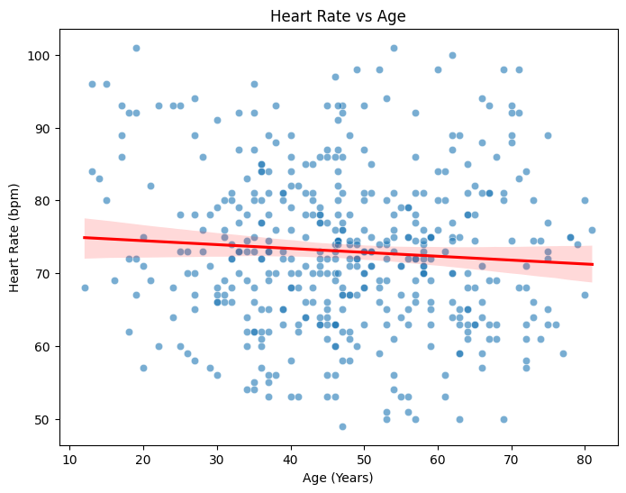
Goal 4 - Prediction of Heart Arrhythmia in the Health Sector [4/9]
The slight downward slope of the regression line at a moderate slope suggests weak negative correlation between heart rate and age, i.e., as age increases, heart rate decreases slightly.
The wide spread of the points along the trend line, however, suggests high variability, i.e., age alone may not be an effective predictor of heart rate.

Slide 19
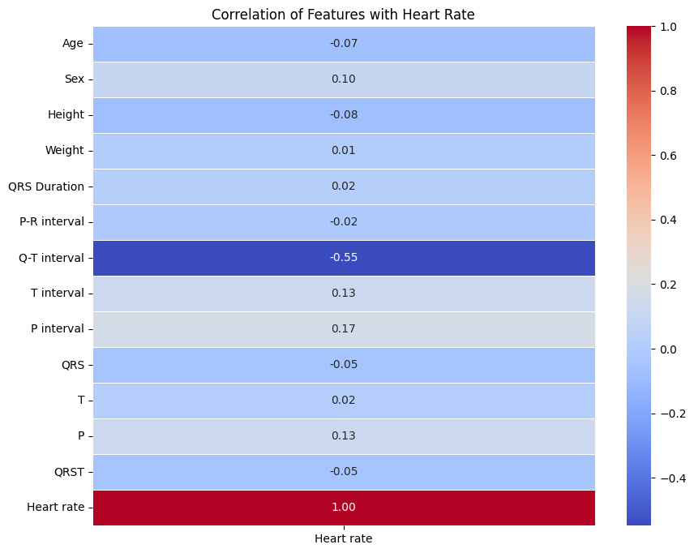
Goal 4 - Prediction of Heart Arrhythmia in the Health Sector [5/9]
Most features show weak correlations, with values close to zero. Notably, the Q-T interval has a moderate negative correlation (-0.55) with heart rate, indicating that as the Q-T interval increases, heart rate tends to decrease.
Other features like P interval and T interval also show slight negative correlations (-0.17 and -0.13, respectively). The heart rate has a perfect negative correlation with itself (-1.00), which is expected.
Overall, the Q-T interval appears to be the most influential feature among those listed in relation to heart rate.

Slide 20
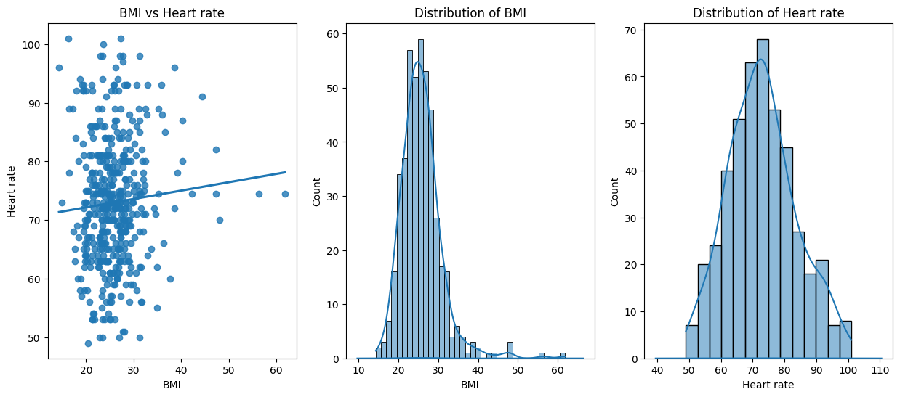
Goal 4 - Prediction of Heart Arrhythmia in the Health Sector [6/9]
The diagram suggests that there may be a relationship between BMI and heart rate, but further analysis is needed to determine if higher BMI values are consistently associated with specific heart rate trends.

Slide 21
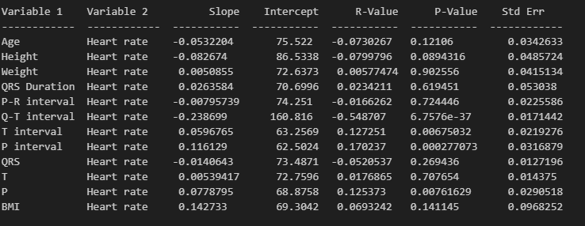
Goal 4 - Prediction of Heart Arrhythmia in the Health Sector [7/9]
The strongest and statistically meaningful relationship exists between Q-T interval and heart rate, while other parameters such as P interval and T interval are significantly correlated. However, the majority of other parameters, i.e., Age, Height, Weight, and BMI, are not significantly correlated with heart rate.

Slide 22
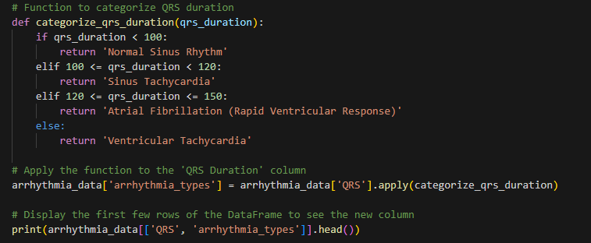
Goal 4 - Prediction of Heart Arrhythmia in the Health Sector [8/9]
Statistical tools to classify the patients within the dataset (i.e. highlight patients with arrhythmias).
According to _Kashani, A., & Barold, S. S. (2005). Significance of QRS complex duration in patients with heart failure. Journal of the American College of Cardiology, 46(12), 2183-2192._, QRS length greater than 120 milliseconds (ms) is generally increased and may indicate conduction abnormalities. This threshold is commonly used in the clinic as a filter for patients who may require cardiac evaluation.
The above scholar informed my function to categorize and later highlight patients with arrhythmias

Slide 23
Goal 4 - Prediction of Heart Arrhythmia in the Health Sector [9/9]
Age | Sex | Height | Weight | QRS Duration | P-R interval | Q-T interval | T interval | P interval | QRS | T | P | QRST | Heart rate | BMI | arrhythmia_types
13 | 0 | 169 | 51 | 100 | 167 | 321 | 174 | 91 | 107 | 66 | 52 | 88 | 84 | 17.86 | Sinus Tachycardia
46.47 | 0 | 110 | 68.17 | 80 | 121 | 367.21 | 156 | 67 | 126 | 25 | 60 | 104 | 74.46 | 56.34 | Atrial Fibrillation (Rapid Ventricular Response)
45 | 0 | 177 | 72 | 94 | 164 | 431 | 158 | 81 | 116 | 36.15 | 37 | 36.72 | 63 | 22.98 | Sinus Tachycardia
13 | 1 | 133 | 68.17 | 96 | 176 | 356 | 171 | 137 | 102 | -63 | 68 | -10 | 96 | 38.54 | Sinus Tachycardia
18 | 0 | 180 | 63 | 93 | 160 | 321 | 172 | 101 | 111 | 72 | 75 | 80 | 92 | 19.44 | Sinus Tachycardia
46.47 | 0 | 166.19 | 68.17 | 83 | 126 | 367.21 | 128 | 60 | 125 | 21 | 48.91 | 102 | 74.46 | 24.68 | Atrial Fibrillation (Rapid Ventricular Response)
26 | 0 | 180 | 97 | 88 | 197 | 404 | 188 | 99 | 119 | 16 | 49 | 88 | 59 | 29.94 | Sinus Tachycardia
31 | 1 | 165 | 56 | 74 | 199 | 384 | 142 | 100 | 110 | 11 | 54 | 92 | 75 | 20.57 | Sinus Tachycardia
34 | 1 | 165 | 60 | 74 | 178 | 302 | 127 | 117 | 112 | 15 | 50 | 104 | 74.46 | 22.04 | Sinus Tachycardia
46.47 | 0 | 120 | 68.17 | 88.92 | 126 | 303 | 164 | 80 | 120 | 17 | 37 | 68 | 74.46 | 47.34 | Atrial Fibrillation (Rapid Ventricular Response)
66 | 0 | 168 | 82 | 86 | 164 | 386 | 169.95 | 111 | 129 | 126 | 56 | 36.72 | 88 | 29.05 | Atrial Fibrillation (Rapid Ventricular Response)
30 | 1 | 160 | 52 | 110 | 154 | 426 | 154 | 94 | 102 | 53 | 60 | 76 | 66 | 20.31 | Sinus Tachycardia
46.47 | 0 | 138 | 68.17 | 88.92 | 145 | 361 | 221 | 80 | 112 | -17 | 14 | 51 | 93 | 35.8 | Sinus Tachycardia
There are 13 patients with arrhythmias as shown in the table above

Slide 24
END OF PROJECT EXAM

